Slide 1
TechPro Academy
Final Project
Lilian Vitsa

Slide 2
Introduction
How can a company maximize their Profits?
Which features affect the Sales Amount of a company?
Do demographics have a vital role?
Are there any trends that customers follow?

Slide 3
Overview
Dataset Variables
Sales Date
Product Category (Clothing, Electronics, Home Appliances)
Sales Amount ($)
Customer Age
Customer Gender (Male, Female, Non-binary)
Customer Location (Japan, Australia, India, USA, UK, Canada)
Product Ratings (1 = low to 5 = high rating)

Slide 4
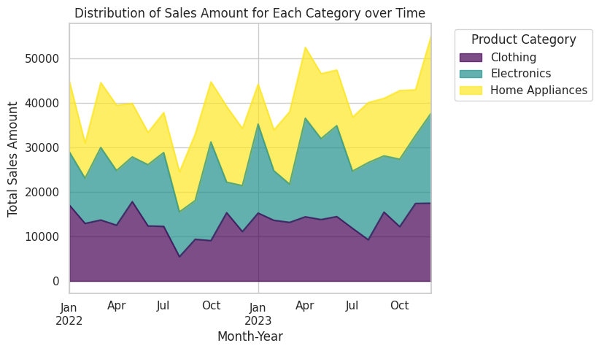
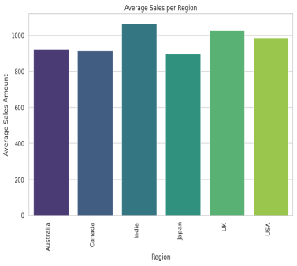
Exploratory Data Analysis
Which Category?
When?

Slide 5
Month Year Clothing Electronics Home Appliances | Month Year Clothing Electronics Home Appliances
0 2022-01 16 13 16 | 0 2022-01 17040 11942 15848
1 2022-02 11 11 11 | 1 2022-02 12909 10139 07880
2 2022-03 13 18 13 | 2 2022-03 13680 16272 14538
3 2022-04 13 12 16 | 3 2022-04 12520 12244 14657
4 2022-05 20 09 12 | 4 2022-05 17796 10035 11988
5 2022-06 11 14 13 | 5 2022-06 12349 13739 07239
6 2022-07 16 19 10 | 6 2022-07 12248 16557 08969
7 2022-08 07 11 09 | 7 2022-08 05451 10038 08987
8 2022-09 10 08 14 | 8 2022-09 9358 08689 14899
9 2022-10 10 20 11 | 9 2022-10 09059 22130 13464
10 2022-11 14 09 12 | 10 2022-11 15317 06851 16963
11 2022-12 14 10 12 | 11 2022-12 11083 10301 12811
12 2023-01 14 19 11 | 12 2023-01 15235 19944 8958
13 2023-02 14 12 08 | 13 2023-02 13614 11116 9134
14 2023-03 14 10 17 | 14 2023-03 13155 08553 16250
15 2023-04 14 20 14 | 15 2023-04 14400 22110 15871
16 2023-05 14 20 16 | 16 2023-05 13786 18137 14582
17 2023-06 12 20 13 | 17 2023-06 14452 20383 12473
18 2023-07 13 15 13 | 18 2023-07 11811 12823 12136
19 2023-08 11 18 15 | 19 2023-08 09251 17303 13460
20 2023-09 16 10 13 | 20 2023-09 15451 12610 12898
21 2023-10 12 16 18 | 21 2023-10 12189 15128 15389
22 2023-11 16 16 13 | 22 2023-11 17390 15224 10257
Products – Profits
Electronics – Summer Period

Slide 6
Products – Profits
Not appearing: February, July, August (Profits)
Appearing January & October of each year (Profits)
Month Year Product Count | Month Year Sales Amount
0 2022-01 45 | 0 2022-01 44830
2 2022-03 44 | 2 2022-03 44490
6 2022-07 45 | 9 2022-10 44653
12 2023-01 44 | 12 2023-01 44137
15 2023-04 48 | 15 2023-04 52381
16 2023-05 50 | 16 2023-05 46505
17 2023-06 45 | 17 2023-06 47308
19 2023-08 44 | 20 2023-09 40959
21 2023-10 46 | 21 2023-10 42706
22 2023-11 45 | 22 2023-11 42871
23 2023-12 54 | 23 2023-12 54984
Marketing - Addvertising Campaigns
Increasing / Reducing Prices

Slide 7
Hypothesis Testing
Customer Location exhibited a statistically significant influence on sales amount.

Slide 8
Prediction Models
Algorithms
Linear & Multilinear Regression
Decision Tree
Random Forest
Clustering / K-Means

Slide 9
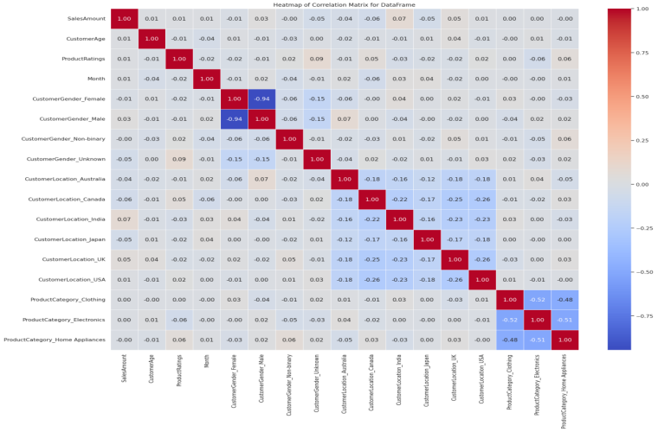
Heatmap
Linear Regression

Slide 10
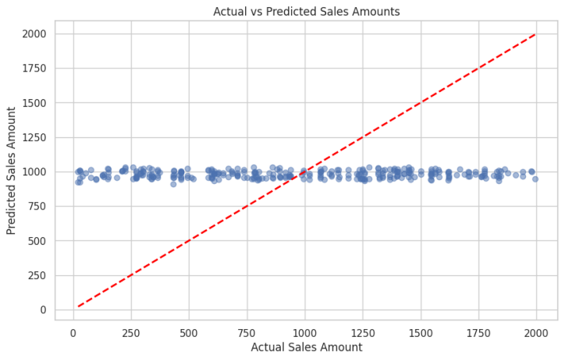
Multilinear Regression
Mean Squared Error: 291141.22045834357
R-squared: -0.00079972486827673
Coefficients

Slide 11
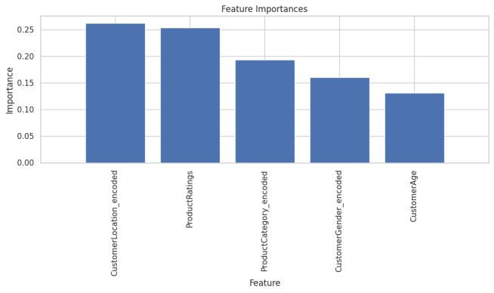
Random Forest

Slide 12
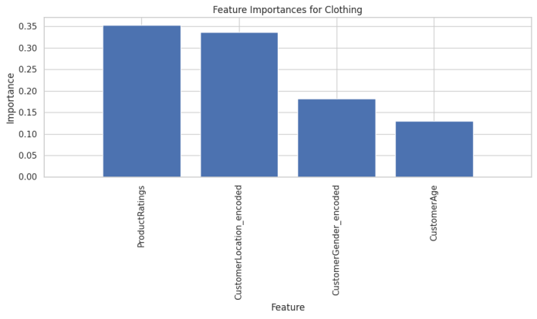
Random Forest​ |Clothing
Product Ratings
Customer Location

Slide 13
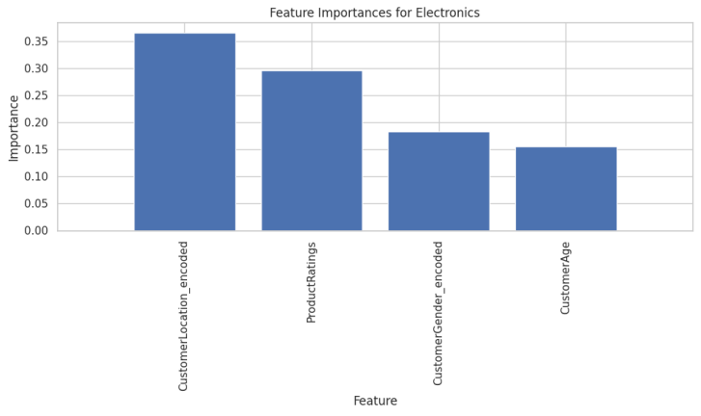
Random Forest​ | Electronics
Customer Location
Product Ratings

Slide 14
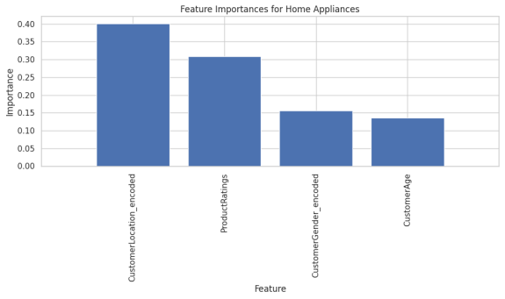
Random Forest​ | Home Appliances
Customer Location
Product Ratings

Slide 15
UK & USA
India & Canada
Australia & Japan
Clothing Location Summary: Total Purchases Percentage of Total Purchases CustomerLocation_encoded Australia 29858 9.42 Canada 54121 17.07 India 67354 21.25 Japan 26493 8.36 UK 66203 20.88 USA 72971 23.02
Electronics Location Summary: Total Purchases Percentage of Total Purchases CustomerLocation_encoded Australia 44481 12.99 Canada 67101 19.59 India 59513 17.38 Japan 34185 9.98 UK 66981 19.56 USA 70209 20.50
Home Appliances Location Summary: Total Purchases Percentage of Total Purchases CustomerLocation_encoded Australia 29153 9.50 Canada 58720 19.13 India 50003 16.29 Japan 34479 11.23 UK 72688 23.68 USA 61934 20.18
Marketing - Addvertising Campaigns
Increasing / Reducing Prices

Slide 16
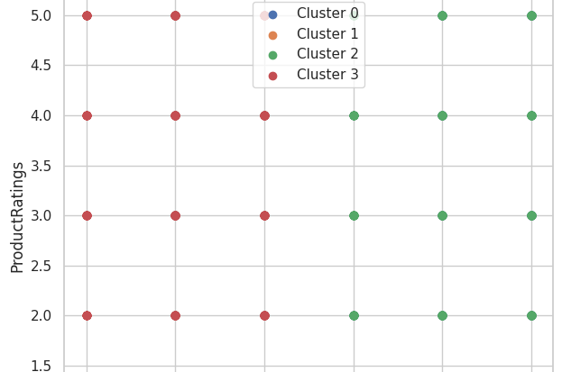
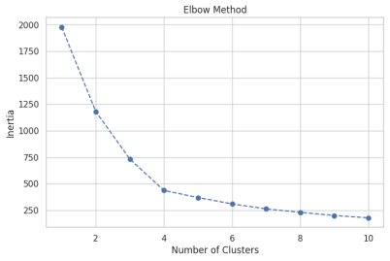
Clustering & K-Means
Elbow Method -> 4 Clusters
Only 2 Appears

Slide 17
Conlclusion
How can a company maximize their Profits?
Which features affect the Sales Amount of a company?
Do demographics have a vital role?
Are there any trends that customers follow?

Slide 18
Thank you
Any Questions?
Lilian Vitsa

